Slide 1

DEPARTMENT OF COMPUTER SCIENCE & ENGINEERING
“FACILITIES AT NHCE”
COURSE NAME:MINI PROJECT
COURSE CODE:19CSE48
Presentation by,
NAME :K.SREEJA
USN:1NH18CS728
Under the Guidance of
Guide Name:Mr.GAGAN S PURAD
Senior assistant professor

Slide 2
Agenda
10/08/20
Introduction
Objectives of the course
Abstract
Problem Definition
Methodology
Objectives of the project
Design
Sample Outputs
Conclusion
10/09/20

Slide 3
Introduction
10/08/20
The NHCE Facilities Information System will display the number of college facilities like maintenance of library, hostels, data center, physical education, soft skills, laboratories etc. By this we can maintain a record of the facilities and also reduce the time for the parents to know more about college.
The main purpose of this is to integrates people, place and process within the built environment. It improving the quality of life of people and the productivity of the core business. So in this project people can know all the details of the college. They have to give there input details like which facility they want to know about.

Slide 4
Objectives of the Course
The Objective of the mini project is the students apply the knowledge in programming
Achieve Object oriented programming through Java
Classes and Objects: Effective way of problem solving and code Reusability.
Features of oop: Encapsulation, Abstraction, Inheritance, Polymorphism
Multithreading
Exception Handling
Packages
Java Collections
File I/O Handling

Slide 5
Abstract
This project totally deals with the details of college. The manual distribution and display of college facilities information is very difficult. In a day there may be hundreds or thousands of persons used to ask about the facilities of the college and the hostel. The time required for this will be more and the parents must travel to college to get this information from the authorities.
The NHCE Facilities Information System will display the number of college facilities like maintenance of library, hostels, data center, physical education, soft skills, laboratories etc. By this we can maintain a record of the facilities and also reduce the time for the parents to know more about college.

Slide 6
Problem Definition
10/08/20
The manual distribution and display of library college facilities information is very difficult. In a day there may be hundreds or thousands of persons used to ask about the facilities of the college and the hostel. The time required for this will be more and the parents must travel to college to get this information from the authorities.
The main purpose of this is to integrates people, place and process within the built environment. It improving the quality of life of people and the productivity of the core business.

Slide 7
Methodology
10/08/20
The proposed system will available online. So anybody who are interested to know the college details and their facilities. And also they can join the student in online.
The benefits of this program include:
This can be used for time reducing process.
User will get to know that fees of the student and seats are available in college.
Easily contact with faculty members.
Reliable and accurate.
User Friendly

Slide 8
Objectives
The main objective of this application project is to simplify the Information about college. The importance of college facilities in improving student outcomes. The growing body of research has found the college facilities that can found a impact on all teachers and also college facilities which is affected to teacher recruitment, retention, commitment and efforts.
The main purpose of Facility is an organizational function which integrates people, place and process within the built environment with the purpose of improving the quality of life of people and the productivity of the core business.
So in this project people can know all the details of the college. They have to give there input details like which facility they want to know about.

Slide 9
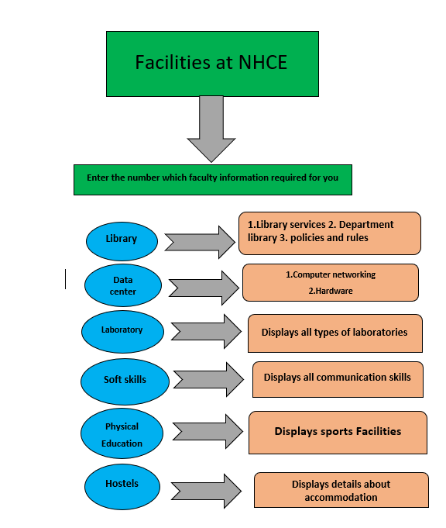
Flow Chart/Algorithm
9

Slide 10
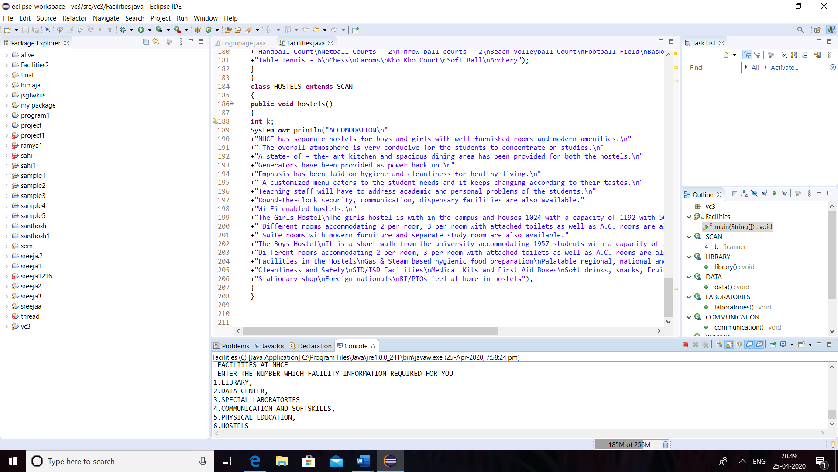
Sample Outputs
Home page

Slide 11
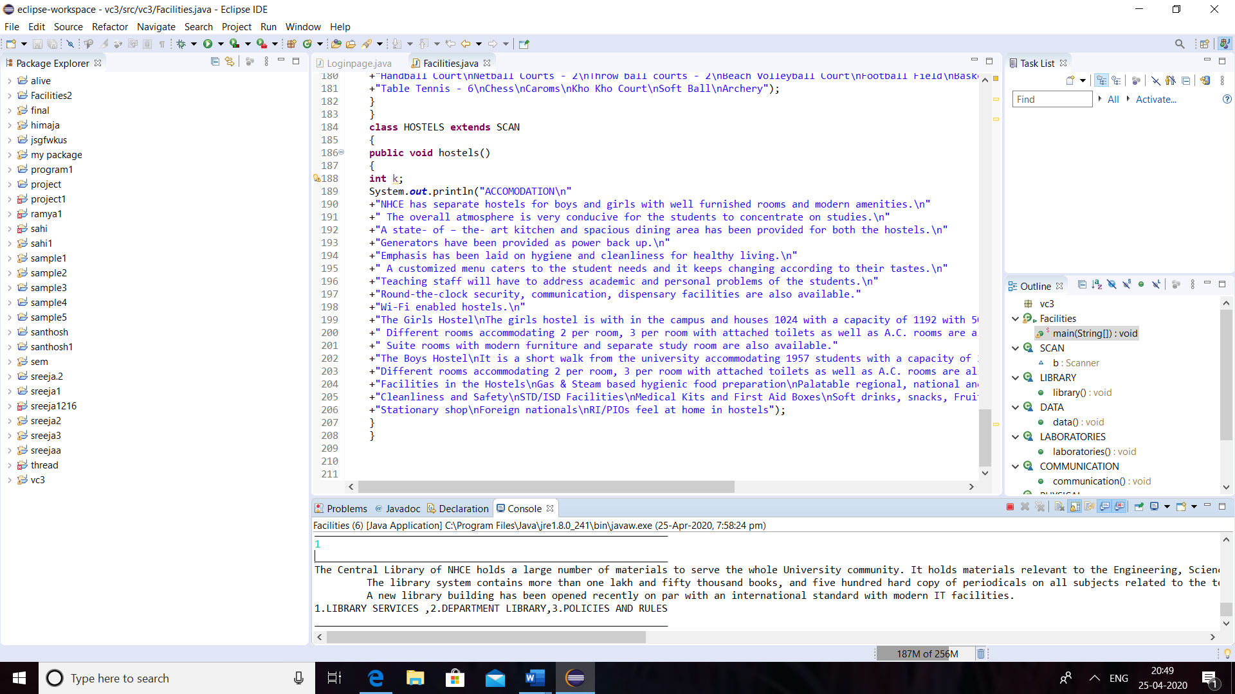
Sample Outputs
Library

Slide 12
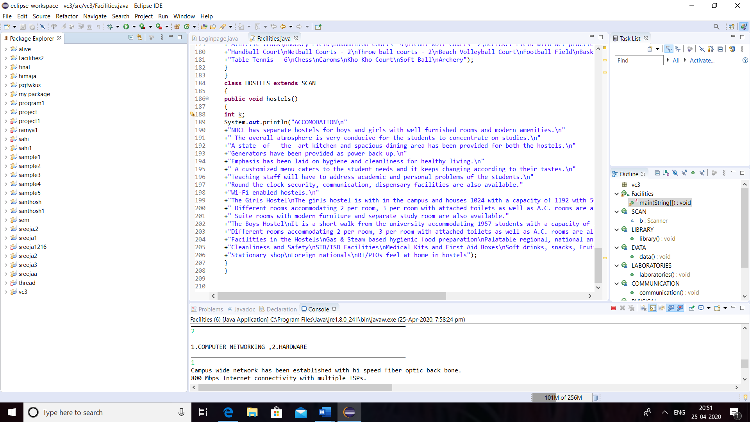
Sample Outputs
Data Center

Slide 13
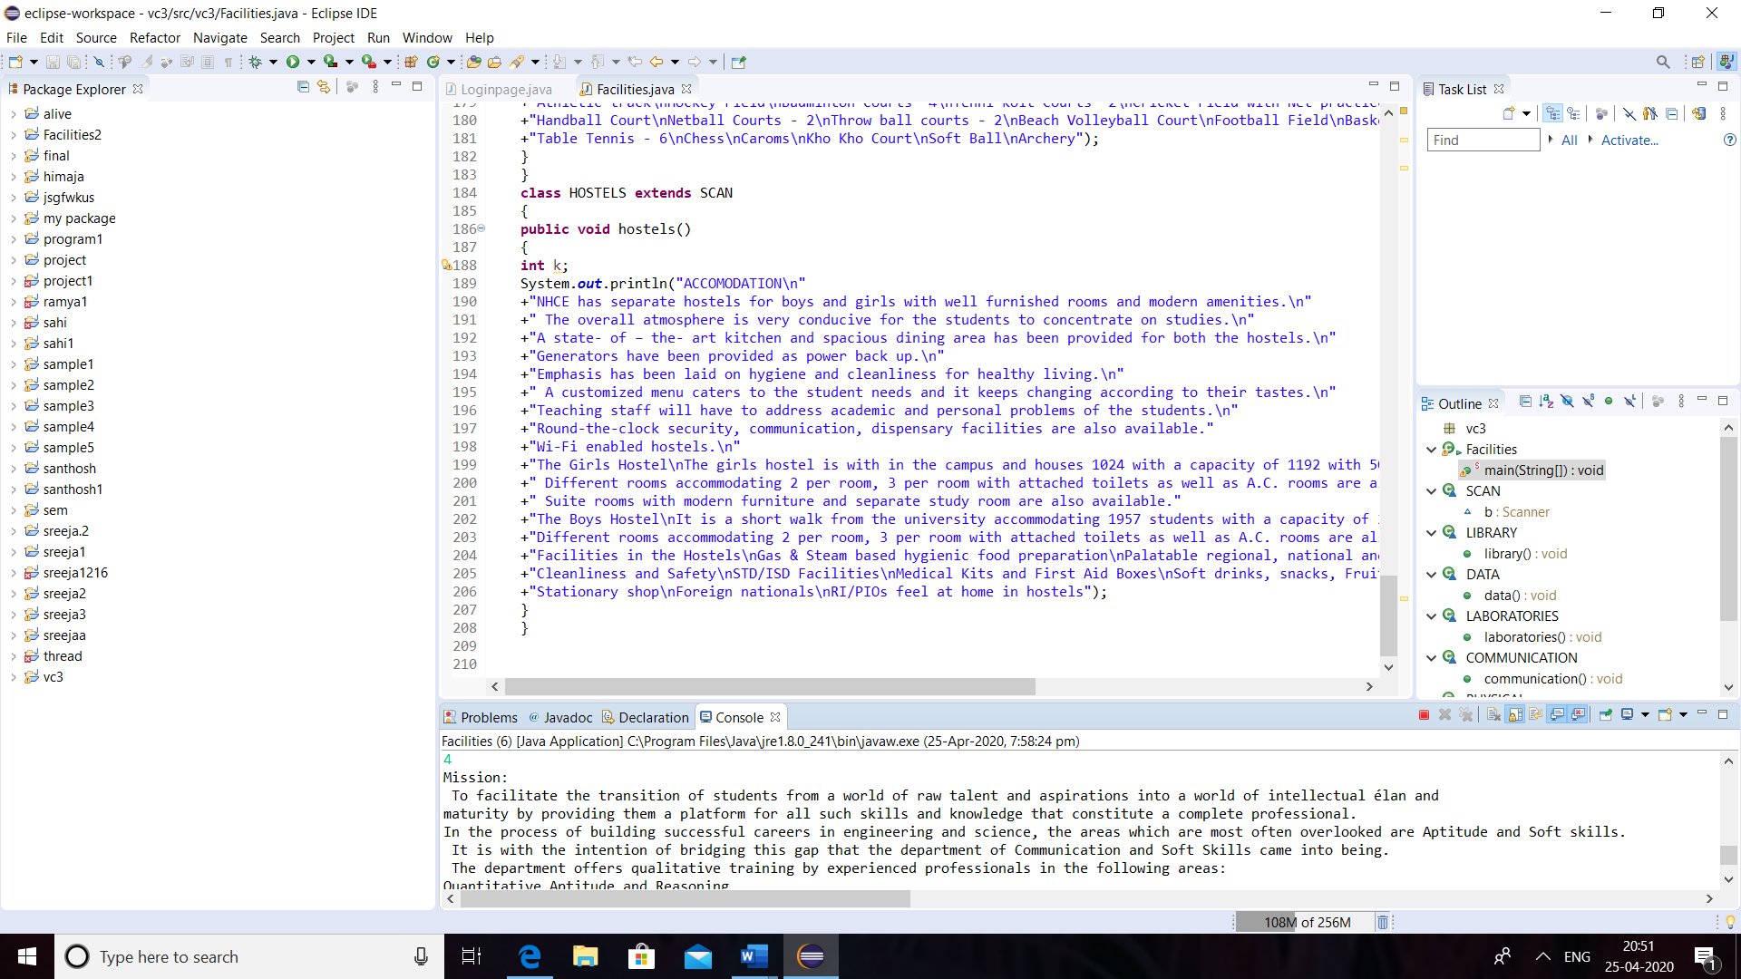
Sample Outputs
Communication and Soft Skills

Slide 14
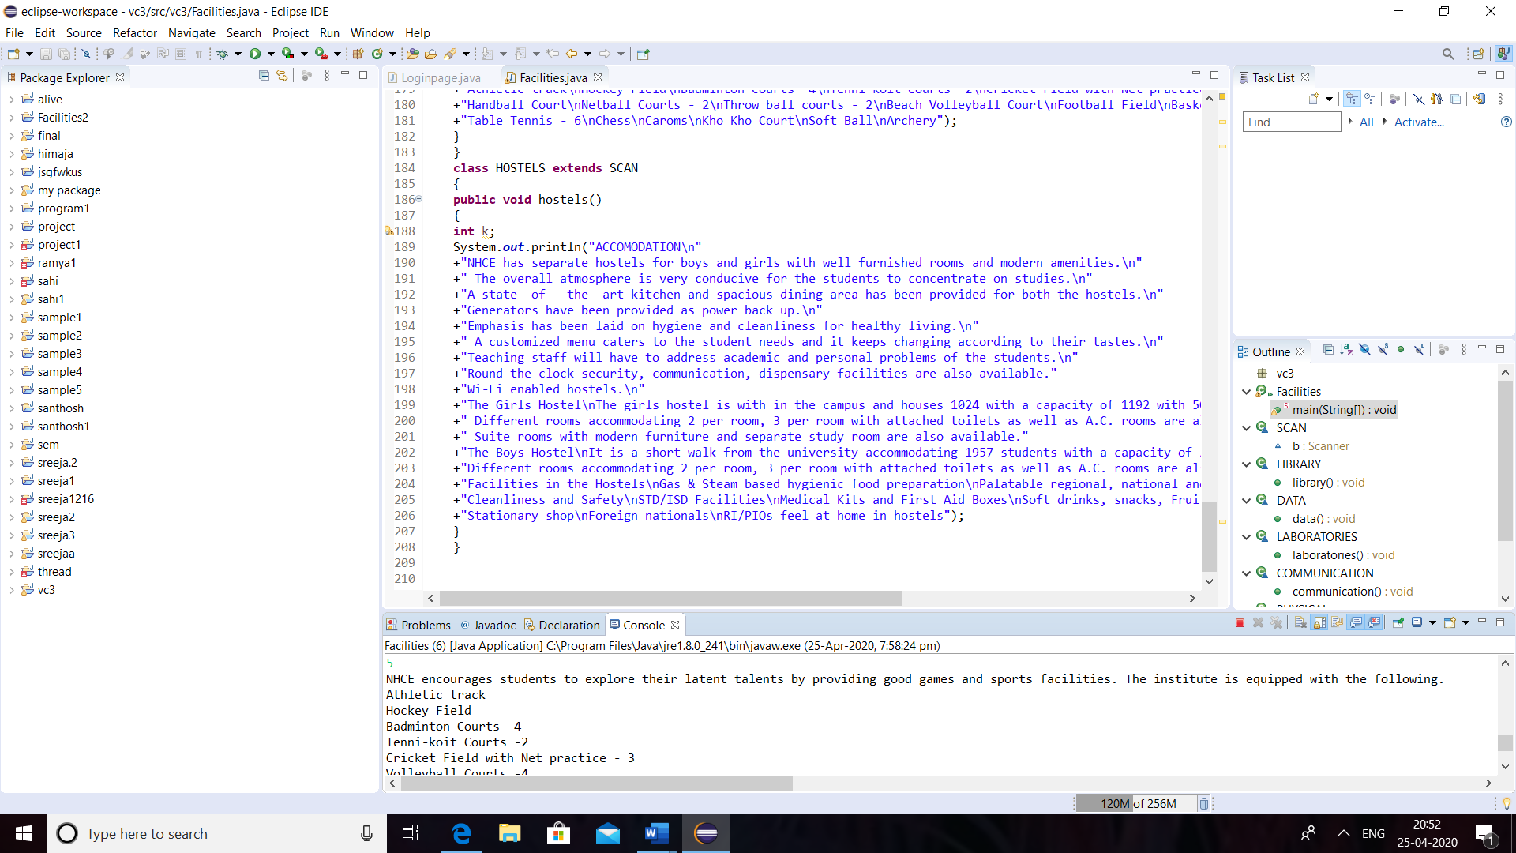
Sample Outputs
Physical Education

Slide 15
THANK YOU

